Slide 1
20277 מערכות בסיסי-נתונים‏ 4 נקודות זכות ברמה רגילה
Relational algebra
All book queries

Slide 2
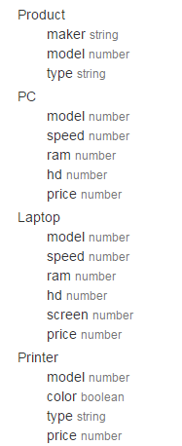
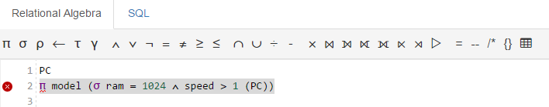
Example from the relation algebra calculator
This summery of all queries in relational algebra , both from the book and from the relational algebra calculator site
http://dbis-uibk.github.io/relax/calc.htm#

Slide 3
כל הסימונים
Π Projection
σ Where clause
ρ rename relation \ rename column
← rename column operator
τ Order by
γ group by

Slide 4
∧ AND
∨ OR
¬ Not
= equal
≠ Not equal
≥ Bigger or equal
≤ less or equal
∩
∪ Union
÷ Division
- Subtraction

Slide 5
⨯ Cross join
⨝ Natural join
⟕ left join
⟖ Right join
⟗ Full outer join
⋉ Left semi join
⋊ Right semi join
▷ Anti join

Slide 6
= Assignment
-- Single line comment
/* Multi line comment
{} Inline relation

Slide 7
Select all \Where
Those tuples of the instructor relation where the instructor is in the “Physics”
department, we write:
σ dept_name=“physics”(instructor)
We can find all instructors with salary greater than $90,000 by writing:
σ salary > 90000 (instructor)
Find all salary in Physics and salary > 90000:
σ dept_name = “Physics” ∧ salary > 90000 (instructor )

Slide 8
Project operation
Show ID , Name and salary from instructor:
Π ID , Name, Salary (instructor)
Find the name of all instructors in the physics department. We write:
Π name (σ dept_name = “physics” (Instructor))

Slide 9
Union – Set Theory איחוד – מתורת הקבוצות
∪ union – איחוד קבוצות
מסמן איחוד של שתי קבוצות – מקבלים קבוצה אחת שמכילה את כל האיברים של הקבוצה הראשונה ואת כל האיברים של הקבוצה השנייה להוציא כפילויות ( distinct)
For example, if A = {1, 3, 5, 7} and B = {1, 2, 4, 6} then
A ∪ B = {1, 2, 3, 4, 5, 6, 7}.
A = {1, 2, 3, 4} and B = {4, 5, r, t} then
A ∪ B = {1, 2, 3, 4, 5, r, t}.

Slide 10
6.1.1.4 The Union Operation
π model (σ ram = 1024 ∧ speed > 1 (PC))
To find the set of all courses taught in the Fall 2009 semester, we write:
π course_id (σ semester = “Fall” ∧ year=2009 (section))
To find the set of all courses taught in the Spring 2010 semester, we write:
π course_id (σ semester = “Spring” ∧ year=2010 (section))

Slide 11
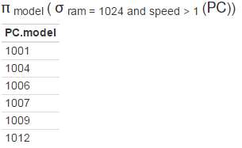
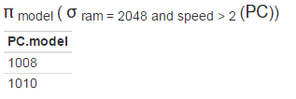
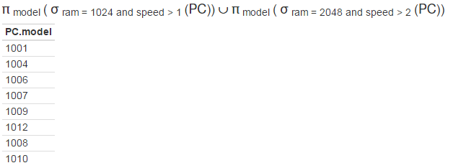
Example of ∪ - union
π model (σ ram = 1024 ∧ speed > 1 (PC)) ∪
π model (σ ram = 2048 ∧ speed > 2 (PC))
Udd U
∪
Results:

